Slide 1

Data analysis
Where are we
and what’s coming up?
Nicola Romanò nicola.romano@ed.ac.uk
6-11-2019

Slide 2


What you should know...
Often in biology we want to establish a relationship between variables
Sometimes we want to compare different groups
Sometimes we don’t have specific groups.
Example: is the response to a drug different between young and old?
Example: is weight dependent on height?
t-test (2 groups)
ANOVA (more than 2 groups or
multiple factors)
Continuous variables
Linear regression / linear models

Slide 3
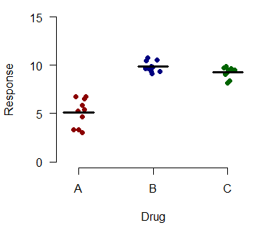
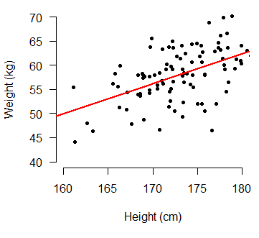
ANOVA and regression
Very similar approaches to model continuous outcomes
ANOVA
Regression
Response = Drug + error
Continuous outcome, discrete predictors
Fitted values = means of the groups
Do the means differ?
Weight = Height + error
Continuous outcome, continuous predictors
Fitted values = y = ax + b
Is there a relationship between Y and X?

Slide 4
Generalising…
Both ANOVA and regression are examples of general linear models (GLMs)
an extremely powerful statistical tool used in many different situations.
s
NOT scary as it looks!
Y = the outcome, what we are measuring (e.g. weight)
X₁, X₂, … = predictors, the variables that influence our outcome (e.g. height, age, …)
β_{1,} β_{2,} … = regression coefficients. Tell us how strongly each predictor influences Y
β₀ = the intercept of the regression line. Gives us the baseline value of Y
ε = residuals

Slide 5
What is coming...
GLMs are great, but it is not always appropriate to use them
- Non independent measurements
Mixed effects models (today and next week)
- Bounded or discrete outcomes (e.g. percentages, counts)
Generalized linear models (GliM) (week 12/13)
Logistic regression and Poisson/count regression
- Sharing data and reproducible research (week 15)
I know, nomenclature like this is confusing, this is what John Nelder, who theorised GLiM says when asked if he regrets the terminology: “I think probably I do. I suspect we should have found some more fancy name for it that would have stuck and not been confused with the general linear model, although general and generalized are not quite the same. I can see why it might have been better to have thought of something else.

Slide 6
What is coming...
And in the second semester we are going to talk about machine learning.
Classification, clustering, big data and much more!

Slide 7
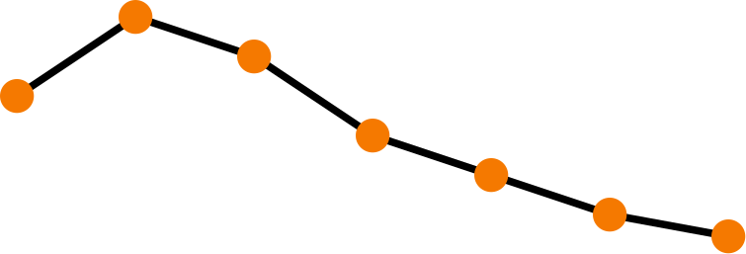
Lecture 9.3
Experimental design VI
Replication, pseudoreplication and repeated measures
Nicola Romanò nicola.romano@ed.ac.uk
6-11-2019

Slide 8
Learning objectives
At the end of this lecture you will be able to:
Determine what the experimental unit in an experiment is
Describe the concept of pseudoreplication and explain the issues associated with it.
Describe and give examples of repeated measures and nested designs.

Slide 9
What is an experimental unit?
An "experimental unit" is typically thought of as one member of a set of objects that are initially equivalent, with each object then subjected to one of several experimental treatments.
Wikipedia
The experimental unit is the entity subjected to an intervention independently of all other units.
The National Centre for the Replacement, Refinement & Reduction of animals in research (NC3R)
The experimental units are the smallest divisions of the collection of the experimental subjects which have been randomly assigned to the different conditions in the experiment and which have responded independently of each other for the duration of the experiment, or which, if allowed to interact during the experimental period, have had the influence of all extraneous variables controlled through randomization.’
Peckam et al., 1969

Slide 10
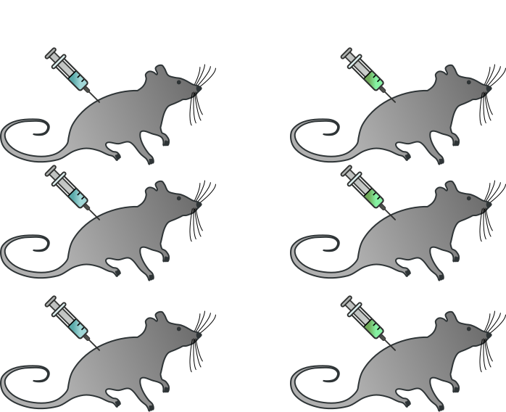
So… what is the experimental unit?

Slide 11
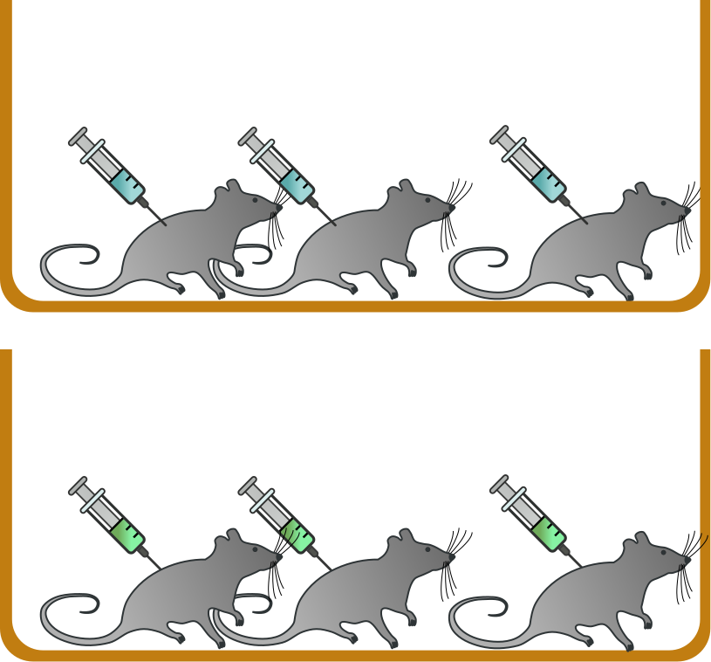
So… what is the experimental unit?

Slide 12
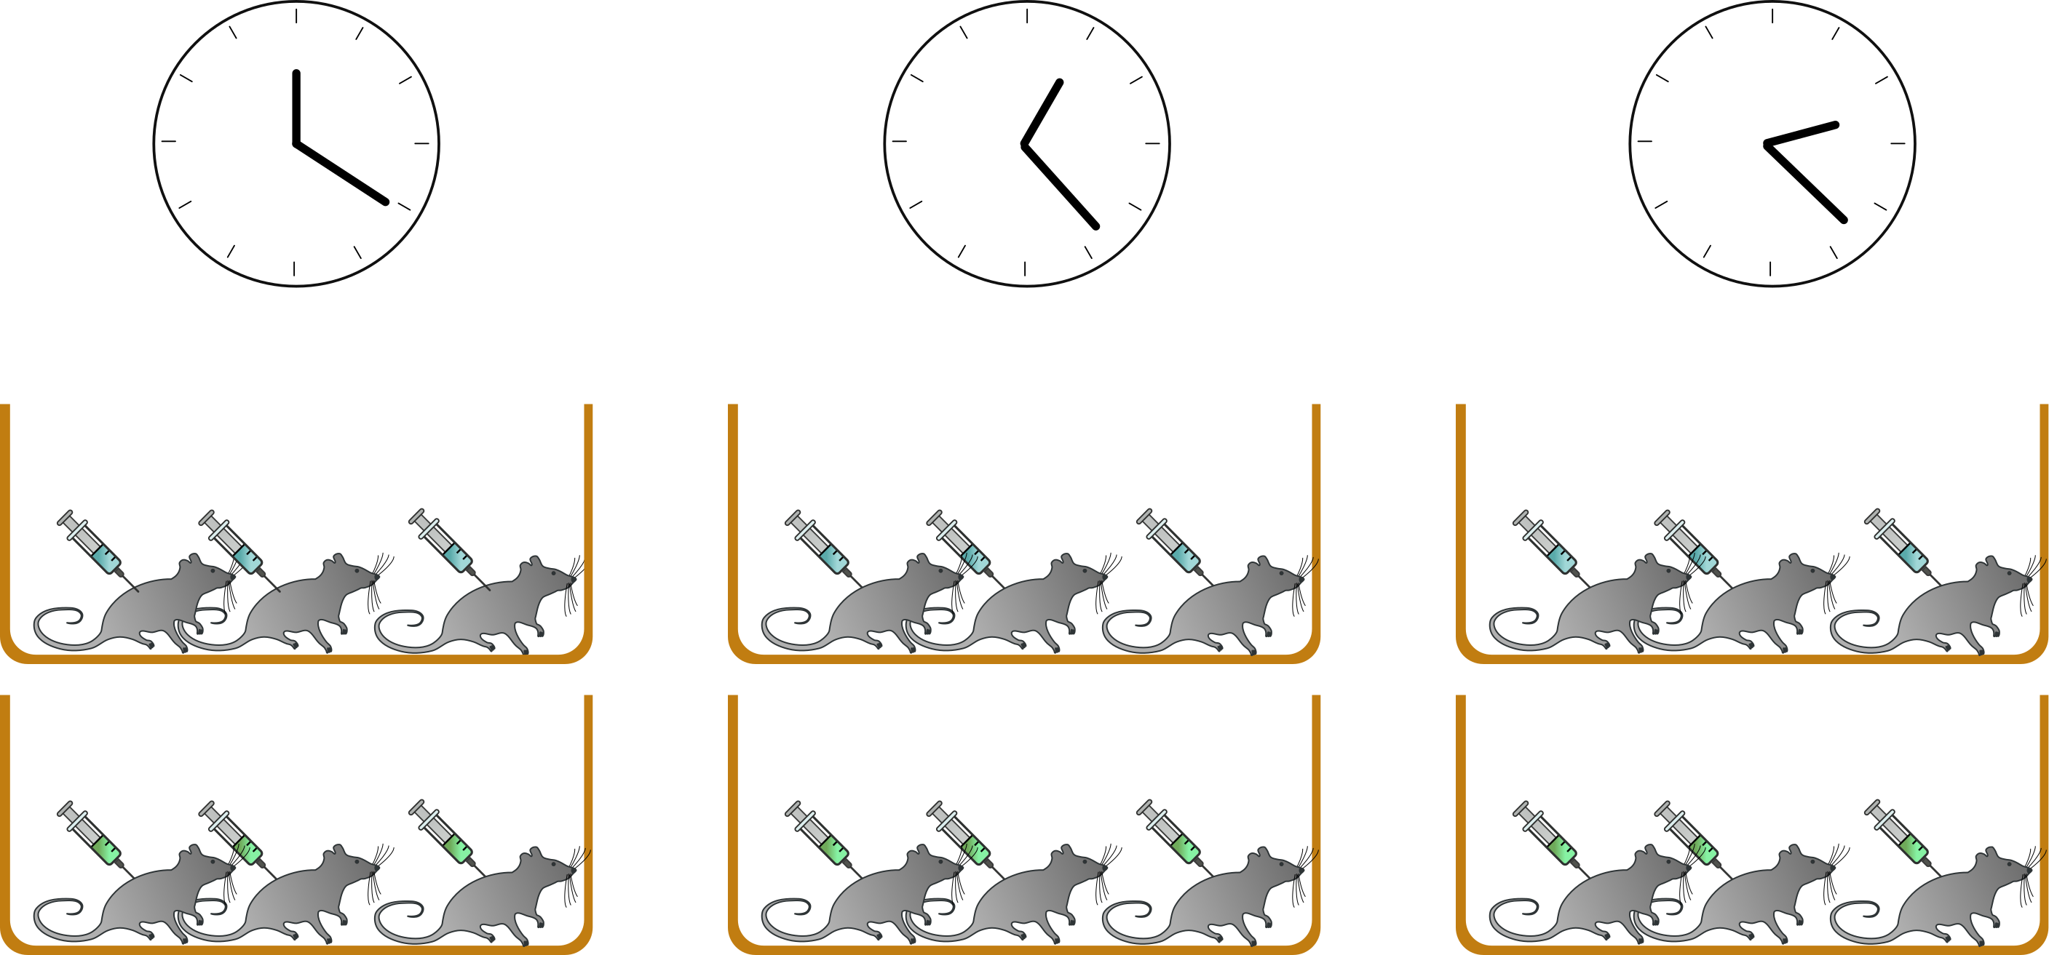
So… what is the experimental unit?

Slide 13
Replication
Replication is the repetition of an experimental condition so that the variability associated with the phenomenon can be estimated.
Two main types of replicates you should be concerned with:
Biological replicates: repetition of the same measurement on different experimental units.
Helps describing the variability in the measured parameter in the population.
Technical replicates: repetition of the same measurement on the same experimental unit and in the same condition.
Take into account the variability due to the experimenter/experimental method.
Notes:
Why do we need replicates? Account for biological variation in whatever is measured. Increase the power of statistical tests
<number>

Slide 14
Replication – an example
We want to evaluate and compare the concentration of cortisol in patients suffering from Addison’s disease (primary adrenal insufficiency) vs control subjects.
We take a morning (9AM) blood sample from each subject and measure the concentration of corticosterone by ELISA.
We need to consider (amongst other things…)
What are the sources of variability?
What are the sources of error?
Notes:
<number>

Slide 15
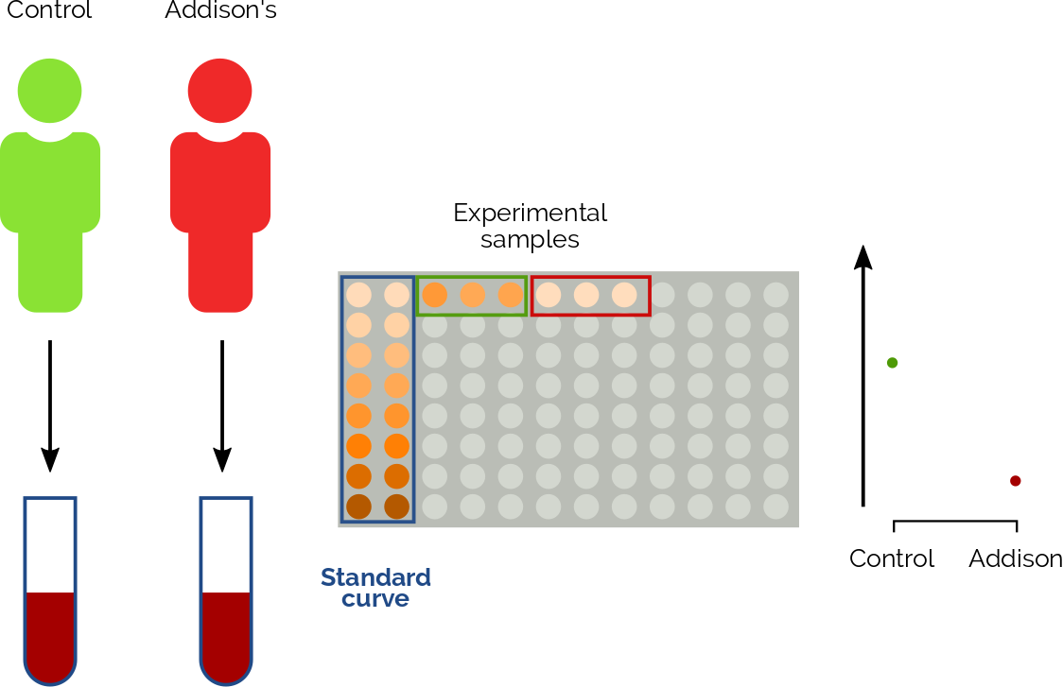
Case 1
What type of replicates do we have?
What sources of variation are we considering here?
What is the n the we should report under this graph?
What statistical test should we use in this case?
Notes:
<number>

Slide 16
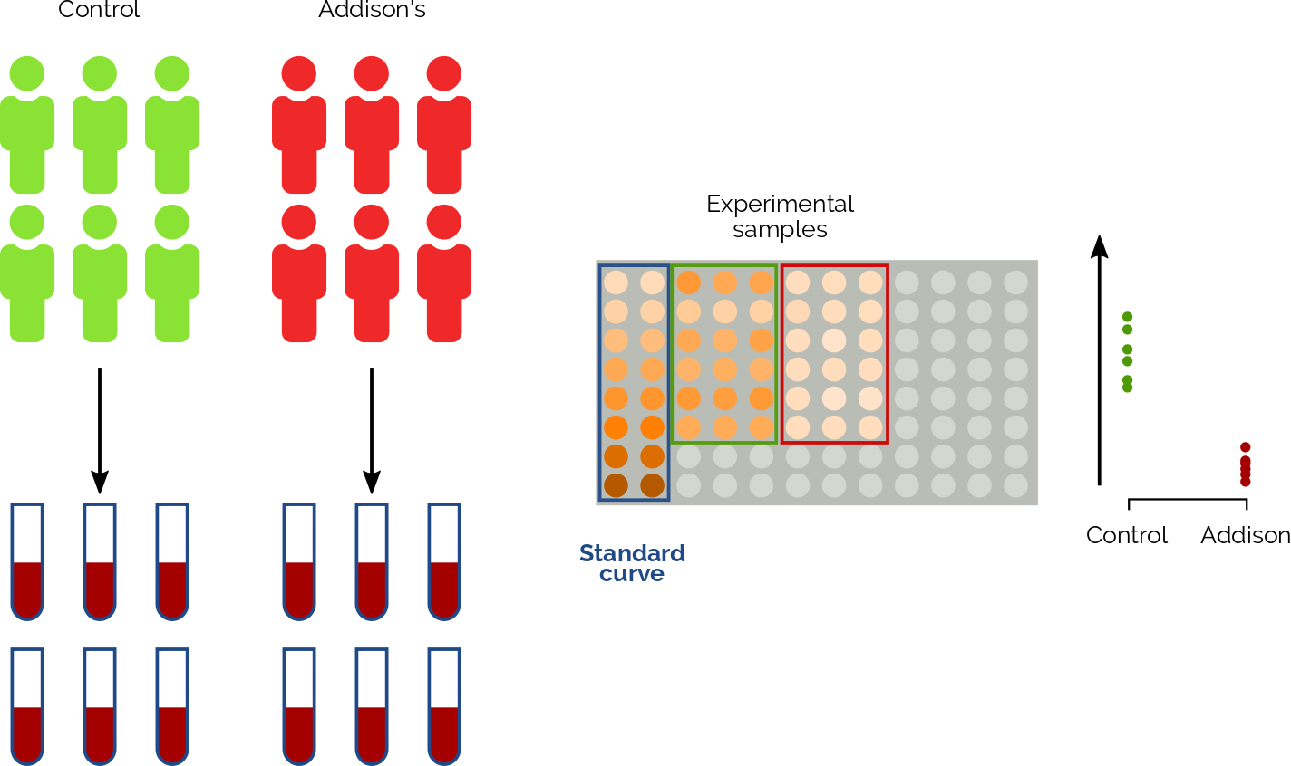
Case 2
What type of replicates do we have?
What sources of variation are we considering here?
What is the n the we should report under this graph?
What statistical test should we use in this case?
Notes:
<number>

Slide 17
What n should I report?
I examine the morphology of cells from metastatic areas from cancer patients.
Patient | Metastatic areas | Number of cells analysed
1 | 4 | 246+189+224+181
2 | 3 | 160+209+250
3 | 2 | 190+223
4 | 2 | 129+257
5 | 4 | 179+255+206+253
TOTAL | 15 | 3151
What n should I report?
5
15
3151
Notes:
<number>

Slide 18
Pseudoreplication
Pseudoreplication: the process of (maliciously or not) artificially inflating the number of samples or replicates in a study by treating correlated observations as if they were independent.
Adapted from Wikipedia
Notes:
<number>

Slide 19

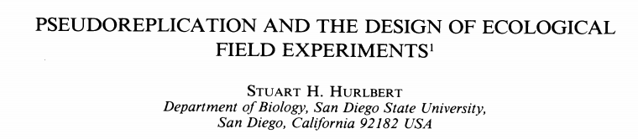
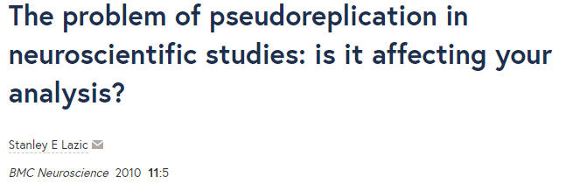
Pseudoreplication in the literature…
Pseudoreplication is extremely common… more than you would imagine!
Big issue in current biomedical research.
~ 50% of studies considered
had some form of pseudoreplication
12% of studies considered (in a single issue of Nature Neuroscience) had some form of pseudoreplication.
36% were suspected (not enough info reported)
Widespread issue. Not limited to neuroscience!
Notes:
<number>

Slide 20
Nested design
Also called hierarchical or multilevel design
Contain (noise) factors that are structured in a hierarchical manner
Extremely common in biology
Very commonly incorrectly analysed!
Example:
Cage → Mouse → β-cells → Secretion vesicles
Forest → Tree → Seed
Notes:
<number>

Slide 21
Repeated measure design
A design where we take measurements from the same experimental unit in several occasions.
Two most common situations
Repeated measures over time ← probably most common in biomed. sciences
Repeated measure over space
Notes:
<number>

Slide 22
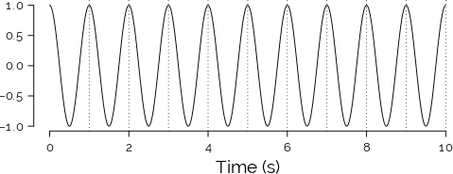
Repeated measures… but how often?
Real signal (1 Hz frequency)
Let’s assume we have a signal with a frequency of 1Hz (1 cycle/second).
How often should we sample to get enough information on the periodic signal?
Notes:
<number>

Slide 23
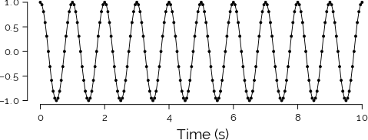
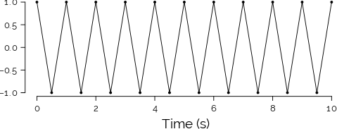
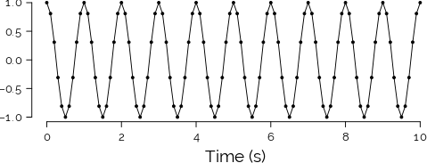
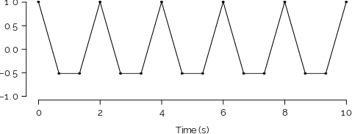
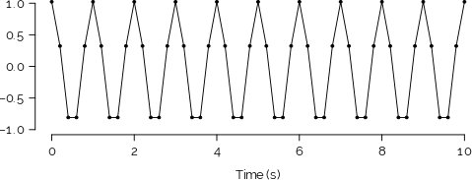
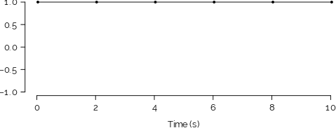
Repeated measures… but how often?
Effect of changing sampling rate
20 Hz
2 Hz
10 Hz
1.5 Hz
5 Hz
1 Hz
Notes:
<number>

Slide 24
The Nyquist rate
For a periodic signal of frequency f, the minimum sampling rate that allows to correctly determine periodicity is 2f (Nyquist rate).
2 Hz – Nyquist rate
Lower frequencies lead to aliasing
Notes:
<number>

Slide 25
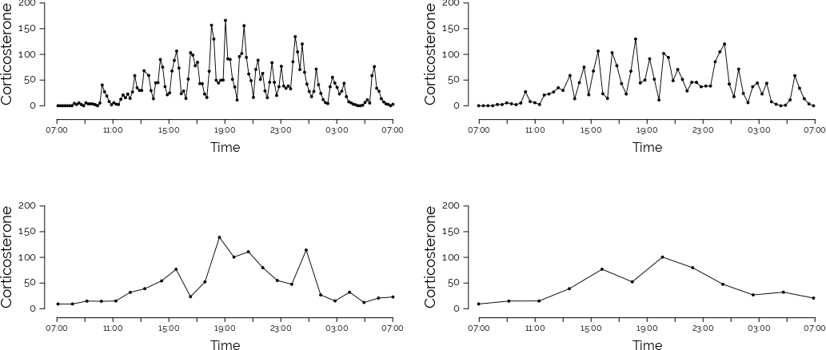
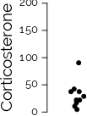
A real-life example
Corticosterone secretion from the rat adrenal gland
1 sample / 10 min 1 sample / 20 min
1 sample / hour 1 sample / 2 hours
10 independent measurements
Notes:
<number>

Slide 26
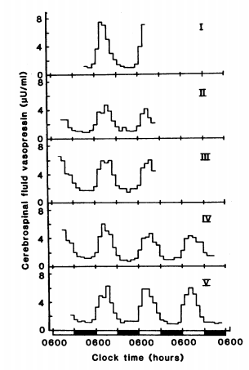
Example
Reppert and colleagues collected samples from 5 cats to measured AVP concentration over the day.
They took 1 sample/hour over the course of several days
What is the experimental unit?
What type of design is this?
What n should be reported in this figure?
Any other comment?
AVP secretion in vivo
Reppert et al. 1981
Notes:
<number>

Slide 27
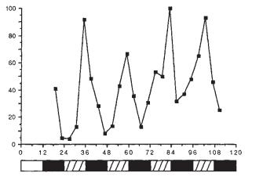
Example
Hardin and colleagues collected samples from Drosophila, to measure per abundance over several days. They collected samples every 4 hours over the course of several day. Each time point they collected RNA from 100 flies, and measured RNA by Southern blot.
What is the experimental unit?
What type of design is this?
What n should be reported in this figure?
Hardin et al.., 1990
Notes:
<number>

Slide 28
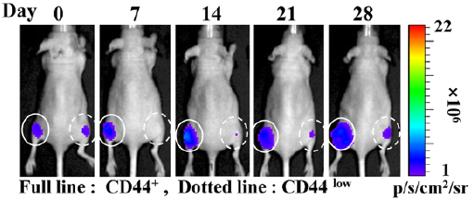
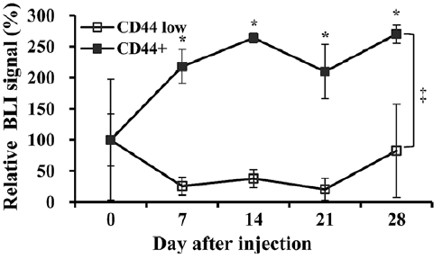
Example
Kim and colleagues implanted two different types of cancer cell (genetically modified so that they emit luminescence) in the left and right mammary gland of mice.
They then imaged the mice over four weeks to determine the growth of the tumoral mass.
What is the experimental unit?
What type of design is this?
What n should be reported in this figure?
Notes:
<number>

Slide 29
Looking for a solution
Repeated measures and nested designs are at risk of pseudoreplication
Is this inevitable? Should I avoid nested designs? Absolutely not!
Nothing wrong with correctly analysed repeated measures or nested designs!
Always think carefully about the design of your experiment. What is your experimental unit?
Always be specific when reporting the number of samples. In a nested design, report n at different levels.
Use correct statistical methods, e.g. mixed effects models ← We will talk about this next week!
Notes:
<number>

